Slide 1
Arduino Operators
The operators are widely used in Arduino programming from basics to advanced levels. It plays a crucial role in every programming concept like C, C++, Java, etc. The operators are used to solve logical and mathematical problems.
For example, to calculate the temperature given by the sensor based on some analog voltage.
The types of Operators classified in Arduino are:
Arithmetic Operators
Compound Operators
Boolean Operators
Comparison Operators
Bitwise Operators

Slide 2
Arithmetic Operators
There are six basic operators responsible for performing mathematical operations in Arduino,
which are listed below:
Assignment Operator ( = ). The Assignment operator in Arduino is used to set the variable's value. It is quite different from the equal symbol (=) normally used in mathematics.
Addition ( + ). The addition operator is used for the addition of two numbers. For example, P + Q.
Subtraction ( - ). Subtraction is used to subtract one value from the another. For example, P - Q.
Multiplication ( * ). The multiplication is used to multiply two numbers. For example, P
* Q.
Division ( / ). The division is used to determine the result of one number divided with another. For example, P/Q.
Modulo ( % ). The Modulo operator is used to calculate the remainder after the division of one number by another number.

Slide 3
Most of the operators are similar to the usual operator used in mathematics. Let's understand the operators with the help of two examples.
Example 1:
Consider the below code.
int b;
void setup ( )
{
4. Serial.begin( 9600 );
5. }
6. void loop ( )
7. {
8. b = 5 + 2;
9. Serial.println(b);
10. }
In the above code, we have assigned the result of the addition of two numbers to b before printing it to the console.
For output, click on the Upload and Serial Monitor button present on the toolbar.
Output: 7

Slide 4
Example 2:
Consider the below code:
int d;
void setup ( ) 3. {
4. Serial.begin( 9600 );
5. }
6. void loop ( ) 7. {
8. d = 5 - 2;
9. Serial.println(d);
10. d = d + 3;
11. Serial.println(d);
12. }

Slide 5
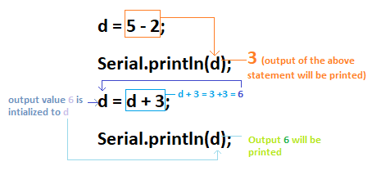
Here, d= d +3 is not operated as a usual mathematical operation. It is the assignment operator where right of the function is evaluated first and is assigned to the left of the equal sign.
Let's consider the below image for better understanding.
Output:
3
6

Slide 6
Similarly, we can perform multiplication, modulo, and division. The int variable will store the integer values. For example, 20/3 = 6.
If we want decimal values to be printed, we need to use the float instead of int. For example,
Consider the below code:
int b;
void setup ( ) 3. {
4. Serial.begin( 9600 ); 5. }
6. void loop ( ) 7. {
8. b = 20.0 / 3; // decimal value is used to force the compiler to print decimal value.
9. Serial.println(b);
10. }
Output: 6.66

Slide 7
Order of mathematical operations
Let's understand the order of operations considered by the Arduino while performing calculation:
Parentheses ( )
Multiplication, division, and modulo
Addition and subtraction
If there are multiple operations next to each other, they will be computed from left to right. Let's understand with an example.
int c;
void setup ( )
{
4. Serial.begin( 9600 );
5. }
6. void loop ( )
7. {
8. c = 2 * 3 / (2 + 1) + 4;
9. Serial.println(c);
10. }
Output: 6

Slide 8
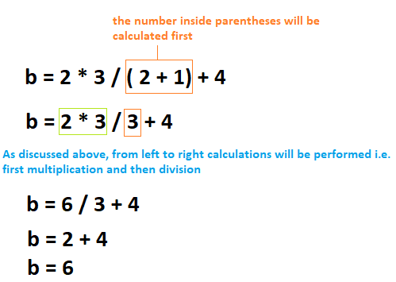
Let's understand how the above output occurred. Consider the below image:

Slide 9
Compound Operators
The compound operators perform two or more calculations at once. The result of the right
operand is assigned to the left operand, as already discussed above. The same condition will apply to all the compound operators, which are listed below:
Let's consider a variable b.
b + +
Here, b = b + 1. It is called the increment operator.
b + =
For example, b + = 4. It means, b = b+ 4.
b - -
Here, b = b - 1. It is called as the decrement operator.
b - =
For example, b - = 3. It means, b = b - 3.

Slide 10
b * =
For example, b * = 6. It means, b = b * 6.
b / =
For example, b / = 5. It means, b = b / 5.
b % =
For example, b % = 2. It means, b = b % 2.
Now, let's use the above operators with two variables, b and c.
b + = c (b = b + c)
b - = c (b = b - c)
b * = c ( b = b * c)
b / = c ( b = b / c)
b % = c ( b = b % c)
We can specify any variable instead of b and c.

Slide 11
Boolean Operators
The Boolean Operators are NOT ( ! ), Logical AND ( & & ), and Logical OR ( | | ). Let's
discuss the above operators in detail.
Logical AND ( & & ). The result of the condition is true if both the operands in the condition are true. Consider the below example:
if ( a = = b & & b = = c )
Above statement is true if both conditions are true. If any of the conditions is false, the statement will be false.
Logical OR ( | | ). The result of the condition is true, if either of the variables in the
condition is true. Consider the below example.
if ( a > 0 | | b > 0 )
The above statement is true, if either of the above condition ( a> 0 or b > 0 ) is true.
NOT ( ! ). It is used to reverse the logical state of the operand. For example, a ! = 2.
The NOT operator returns the value 1 or TRUE when the specified operand is FALSE. It also reverses the value of the specified expression.

Slide 12
Comparison Operators
The comparison operators are used to compare the value of one variable with the other.
The comparison operators are listed below:
less than ( < ). The less than operator checks that the value of the left operand is less than the right operand. The statement is true if the condition is satisfied. Consider the below code.
int b;
int c ;
void setup ( )
{
Serial.begin( 9600 );
}

Slide 13
6. void loop ( )
7. {
8. b = 3;
9. c = 5;
10. if ( b < 4)
11. Serial.println(b);
12. if ( c < 4)
13. Serial.println(c);
14. }
Output: 3
In the above code, if any of the two statement is correct, the corresponding value of the
variable will be printed. Here, only first condition is correct. Hence, the value of b will be printed.

Slide 14
greater than ( > ). The less than operator checks that the value of the left side of a statement is greater than the right side. The statement is true if the condition is satisfied. For example, a > b.
If a is greater than b, the condition is true, else false.
equal to ( = = ). It checks the value of two operands. If the values are equal, the condition is satisfied.
For example, a = = b.
The above statement is used to check if the value of a is equal to b or not.
not equal to ( ! = ). It checks the value of two specified variables. If the values are not equal, the condition will be correct and satisfied.
For example, a ! = b.

Slide 15
less than or equal to ( < = ). The less or equal than operator checks that the value of left
side of a statement is less or equal to the value on right side. The statement is true if either of the condition is satisfied.
For example, a < = b
It checks the value of a is less or equal than b.
o greater than or equal to ( > = ). The greater or equal than operator checks that the value
of the left side of a statement is greater or equal to the value on the right side of that statement. The statement is true if the condition is satisfied.
For example, a > = b
It checks the value of a is greater or equal than b. If either of the condition satisfies, the statement is true.

Slide 16
Bitwise Operators
The Bitwise operators operate at the binary level. These operators are quite easy to use. There
are various bitwise operators.
Some of the popular operators are listed below:
bitwise NOT (~). The bitwise NOT operator acts as a complement for reversing the bits.
For example, if b = 1, the NOT operator will make the value of b = 0. Let's understand with another example.
0 0 1 1 // Input or operand 1 (decimal value 3)
1 1 0 0 // Output (reverses the input bits) decimal value is 12
bitwise XOR (^). The output is 0 if both the inputs are same, and it is 1 if the two input bits are different.
For example,
1 0 0 1 // input 1 or operand 1
0 1 0 1 // input 2
3. 1 1 0 0 // Output ( resultant - XOR)

Slide 17
bitwise OR (|). The output is 0 if both of the inputs in the OR operation are 0. Otherwise, the output is 1. The two input patterns are of 4 bits.
For example,
1 1 0 0 // input 1 or operand 1
0 0 0 1 // input 2
3. 1 1 0 1 // Output ( resultant - OR)
o bitwise AND ( & ). The output is 1 if both the inputs in the AND operation are 1.
Otherwise, the output is 0. The two input patterns are of 4 bits.
For example,
1 1 0 0 // input 1 or operand 1
0 1 0 1 // input 2
0 1 0 0 // Output ( resultant - AND)

Slide 18
bitwise left shift ( < < ). The left operator is shifted by the number of bits defined by the right operator.
bitwise right shift ( > > ). The right operator is shifted by the number of bits defined by the left operator.

Slide 19
Arduino Serial Communication
The serial communication is a simple scheme that uses the UART (Universal Asynchronous
Receiver/Transmitter) on the Microcontroller. It uses,
5V for logic 1 (high)
0V for logic 0 (low)
For a 3.3V board, it uses
3V for logic 1 (high)
0V for logic 0 (low)
Every message sent on the UART is in the form of 8 bits or 1 byte, where 1 byte = 8 bits. The
messages sent to the computer from Arduino are sent from PIN 1 of the Arduino board, called Tx (Transmitter). The messages being sent to the Arduino from the computer are received on PIN 0, called Rx (Receiver).

Slide 20
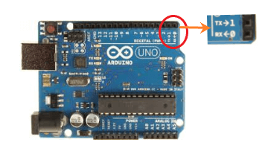
These two pins on the Arduino UNO board look like the below image:

Slide 21
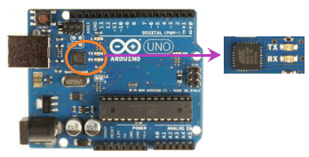
When we initialize the pins for serial communication in our code, we cannot use these two pins (Rx and Tx) for any purpose. The Tx and Rx pins are also connected directly to the computer. The pins are connected to the serial Tx and Rx chip, which acts as a serial to USB translator. It acts as a medium for the computer to talk to the Microcontroller. The chip on the board looks like the below image:

Slide 22
The object can include any number of data members (information) and member functions (to call actions).
The Serial.begin() is a part of the serial object in the Arduino. It tells the serial object to perform initialization steps to send and receive data on the Rx and Tx (pins 1 and 0).
Let's discuss Serial.begin( ) in detail.
Arduino Mega has four serial ports. The Tx pins on the Mega board are listed below:
1 (TX)
18 (TX)
16 (TX)
14 (TX)
The Rx pins on the Mega port are listed below:
0 (RX)
19 (RX)
17 (RX)
15 (RX)

Slide 23
The communication with the Tx and Rx pins would cause interference and failed uploads to the
particular board. If we require a serial port for communication, we need to use a USB-to serial adapter. It is a mini USB connector, which converts the USB connection to the Serial RX and TX. We can directly connect the adapter to the board.
There are five pins present on the USB-to serial adapter, including RX, TX, reset button, and GND (Ground).

Slide 24
Serial.begin ( )
The serial.begin( ) sets the baud rate for serial data communication. The baud rate signifies the data rate in bits per second. The default baud rate in Arduino is 9600 bps (bits per second). We
can specify other baud rates as well, such as 4800, 14400, 38400, 28800, etc. The Serial.begin( ) is declared in two formats, which are shown below:
begin(speed )
begin(speed, config) where,
serial: It signifies the serial port object.
speed: It signifies the baud rate or bps (bits per second) rate. It allows long data types.
config: It sets the stop, parity, and data bits.

Slide 25
Example 1:
1. void setup ( ) 2. {
3. Serial.begin(4800); 4. }
5. void loop ( ) 6. {
7. }
The serial.begin (4800 ) open the serial port and set the bits per rate to 4800. The messages in Arduino are interchanged with the serial monitor at a rate of 4800 bits per second.

Slide 26
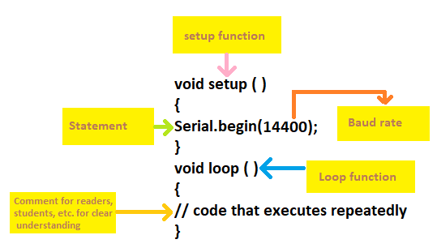
Example 2:
It is shown below:

Slide 27
Serial.print()
The serial.print ( ) in Arduino prints the data to the serial port. The printed data is stored in the ASCII (American Standard Code for Information Interchange) format, which is a human-
readable text. Each digit of a number is printed using the ASCII characters.
The printed data will be visible in the serial monitor, which is present on the right corner on the toolbar.
The Serial.print( ) is declared in two formats, which are shown below:
print(value )
print(value, format)
Note: In Serial.print( ), S must be written in uppercase.

Slide 28
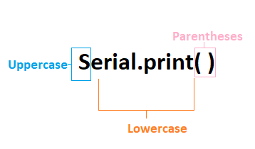
Where,
serial: It signifies the serial port object.
print: The print() returns the specified number of bytes written.
value: It signifies the value to print, which includes any data type value.
format: It consists of number base, such as OCT (Octal), BIN (Binary), HEX (Hexadecimal), etc. for the integral data types. It also specifies the number of decimal places.

Slide 29
Serial.print(value)
The serial.print() accepts the number using the ASCII character per digit and value upto two decimal places for floating point numbers.
Example 1:
Serial.print(15.452732)
Output:
15.45
It sends bytes to the printer as a single character. In Arduino, the strings and characters using the Serial.print() are sent as it is.
Example 2:
Serial.print("Hello Arduino")
Output:
"Hello Arduino"

Slide 30
Serial.print(value, format)
It specifies the base format and gives the output according to the specified format. It includes the
formats Octal -OCT (base 8), Binary-BIN (base 2), Decimal-DEC (base 10), and Hexadecimal- HEX (base 16).
Let's understand by few examples.
Example 1:
Serial.print(25, BIN)
Output:
11001
It converts the decimal number 25 to binary number 11001.
Example 2:
Serial.print(58, HEX)
Output:
3A
It converts the decimal number 58 to hexadecimal number 3A.

Slide 31
Example 3:
Serial.print(58, OCT) Output:
72
It converts the decimal number 58 to octal number 72.
Example 4:
Serial.print(25, DEC)
Output:
25
The conversion is from decimal to decimal. So, the output will be the same.

Slide 32
Printing a Tab space
We can also print the tab in the output.
Serial.print(" \ t '') is used to print the tab in the output program.
Serial.println ( )
The Serial.println ( ) means print line, which sends the string followed by the carriage return ('\r'
or ASCII 13) and newline ('\n' or ASCII 10) characters. It has a similar effect as pressing the Enter or Return key on the keyboard when typing with the Text Editor.
The Serial.println( ) is also declared in two formats, which are shown below:
println( value )
println( value, format)

Slide 33
What is the difference between Serial.print( ) and Serial.println( )?
The text written inside the open and closed parentheses in the Serial.println( ) moves in a new line. With the help of Serial.print( ) and Serial.println( ), we can figure the order and execution of certain things in our code.
1. void setup ( )
2. {
3. Serial.begin ( 4800); 4. }
5. void loop ( )
6. {
7. Serial.print(" Hello"); 8. delay(1000);
Serial.println("Arduino"); // It will print Arduino followed by a new line.
delay ( 1500); // delay of 1.5 seconds between each printed line.
11. }

Slide 34
Click on the Upload button-> Serial monitor for the output.
In the output, the word Hello will appear followed by the word Arduino 1 second later. After 1.5 second, another line will be printed.
Output
Hello Arduino
Hello Arduino // The next line will be printed after the specified duration.
.
4. .
5. .
6. .
7. The output will be printed repeatedly.

Slide 35
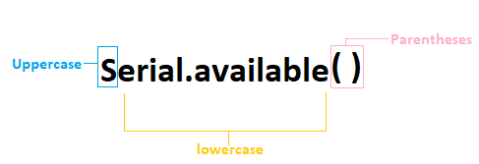
Serial.available( )
The Serial.available( ) function in Arduino gets the stored bytes from the serial port that are available for reading. It is the data, which is already stored and arrived in the serial buffer. The serial buffer in Arduino holds the 64 bytes.
Serial.available( ) function inherits from the utility class called stream. The stream is only
invoked when the function relying on it is called. The stream class is considered as the base class for binary and character-based streams.

Slide 36
Let's understand with an example.
int arrivingdatabyte = 0; // initializing the incoming serial byte
void setup( )
{
4. Serial.begin(9600); // 9600 is the data rate in bps (bits per second).
5. }
6. void loop( ) // loop function that executes repeatedly
7. {
8. if(Serial.available( ) > 0) // It will only send data when the received data is greater than 0.
9. {
arrivingdatabyte = Serial.read( ); // It will read the incoming or arriving data byte
Serial.print("data byte received:");
Serial.println(arrivingdatabyte, DEC); // here, DEC means Decimal
13. }
14. }

Slide 37
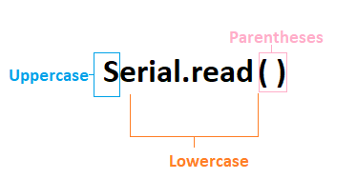
Arduino Serial.read( )
The Serial.read( ) in Arduino reads the incoming serial data in the Arduino. The int data type is used here. It returns the first data byte of the arriving serial data. It also returns -1 when no data is available on the serial port.
The syntax used in the Arduino programming is Serial.read( ) Where,
serial: It signifies the serial port object.

Slide 38
The data is stored in the form of bytes, where 1 byte = 8 bits. Let's understand with an example.
int arrivingdatabyte;
void setup( ) {
Serial.begin(9600);
4. }
5. void loop( ) {
6. if(Serial.available( ) > 0) {
7. arrivingdatabyte = Serial.read( ); // It will read the incoming or arriving data byte
8. Serial.print("data byte received:");
9. Serial.println(arrivingdatabyte);
10. }
11. }
The above code clearly explains that the Serial.available( ) is used to get the available number of
bytes if it is greater than 0. The Serial.read( ) function will read the data from the data byte and print a message if the data is received. The data is sent from the serial monitor to the Arduino.

Slide 39
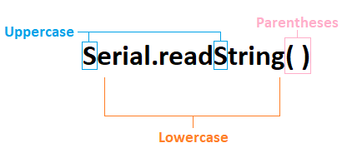
Serial.readString( )
It reads the incoming serial data from the serial buffer in the string. The String data type is used here.
Let's understand with an example.
String b;
void setup( )
{
4. Serial.begin(4800);
5. }

Slide 40
6. void loop( ) 7. {
8. while( Serial.available( ) )
9. {
b = Serial.readString( );
Serial.println(b);
12. }
13. }
The above code clearly explains that the Serial.readString( ) is used to read the serial data into
the string. The string specified here is b. The data in the Serial function is read as a string in the above code.
How serial data is read by Serial.readString( ) and Serial.read( )?
The Serial.read( ) function reads the data in terms of bytes, while the Serial.readString( ) reads the data in the term of string.

Slide 41
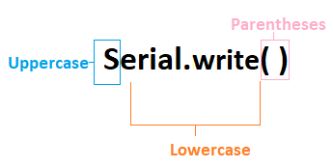
Serial.write( )
It sends the binary data to the serial port in Arduino. The data through Serial.write is sent as a series of bytes or a single byte. The data type is size_t. The Serial.write( ) function will return the number of written bytes. If we want to send the digits of numbers represented by the characters, we need to use the Serial.print( ) function instead of Serial.write( ).

Slide 42
The Serial.write( ) is declared in three formats, which are shown below:
write(str )
write(value )
write(buffer, len)
where,
Serial: It signifies the serial port object.
str: The str means string, which sends the data as a series of bytes.
buffer: It is an array that is used to send the data as a series of bytes.
value: It sends the data to the Arduino as a single byte.
len: It signifies the number of bytes, which can be sent from the array.

Slide 43
Let's understand with a simple example.
1. void setup( )
2. {
3. Serial.begin(14400);
4. }
5. void loop( )
6. {
Serial.write(55); // the specified value is 55.
// Serial.write( ) send the data as a byte with this value (55).
int Bytestosend = Serial.write( " Arduino" );
// It sends the Arduino string.
//The length of the string is a return parameter in this function.
12. }

